Slide 1
Logic expression normalizer
Object Oriented Programming
Lecturer: Ph.D. Trần Thế Hùng.
June 2024

Slide 2
GROUP 36
Name | ID | Assignment
Lê Thanh Tùng Nguyễn Tài Huy | 20226070 20184273 | Designed the Model. Developed the input and output screens. Created the tables. Implemented all the classes to build a complete model. Wrote all the methods in the Controller to streamline the project workflow. Documents and Slide

Slide 3
Problem statement
Normalize a logic expression using the implementation of the Quine-McCluskey method
The same expression can be implemented using fewer logic gates

Slide 4
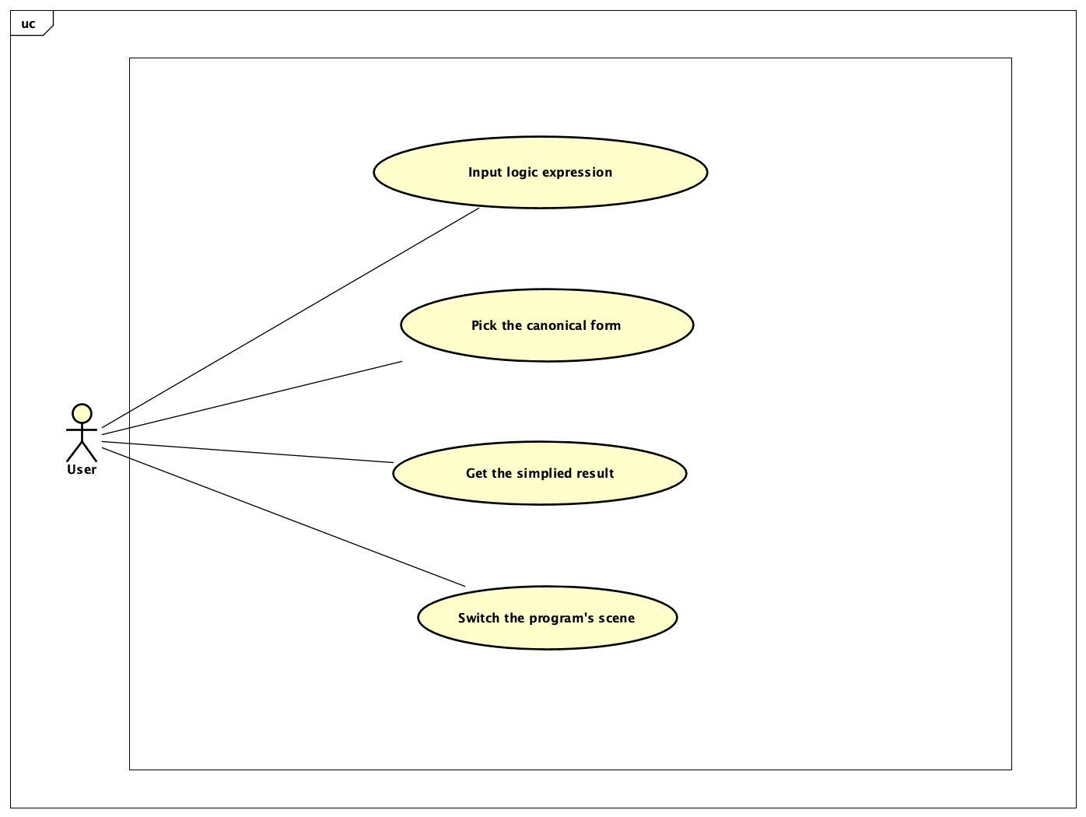
Use case diagram

Slide 5
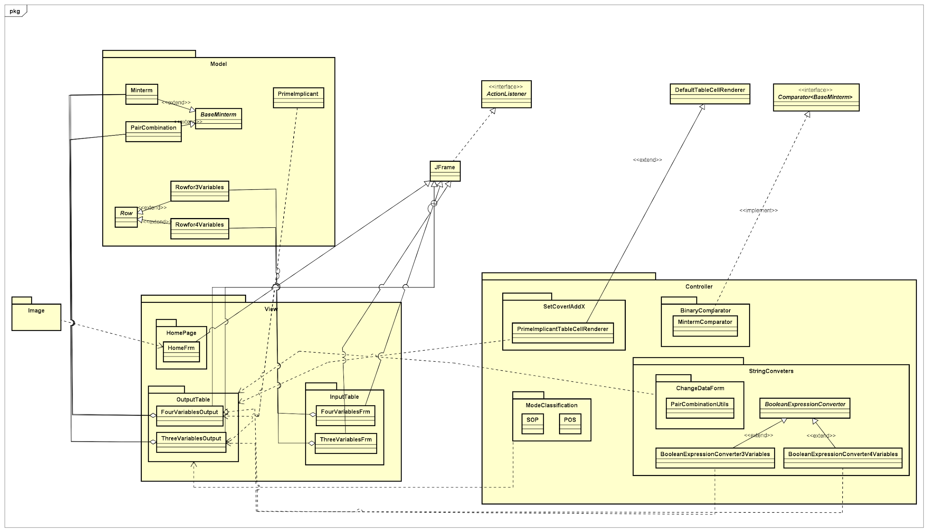
General class diagram

Slide 6
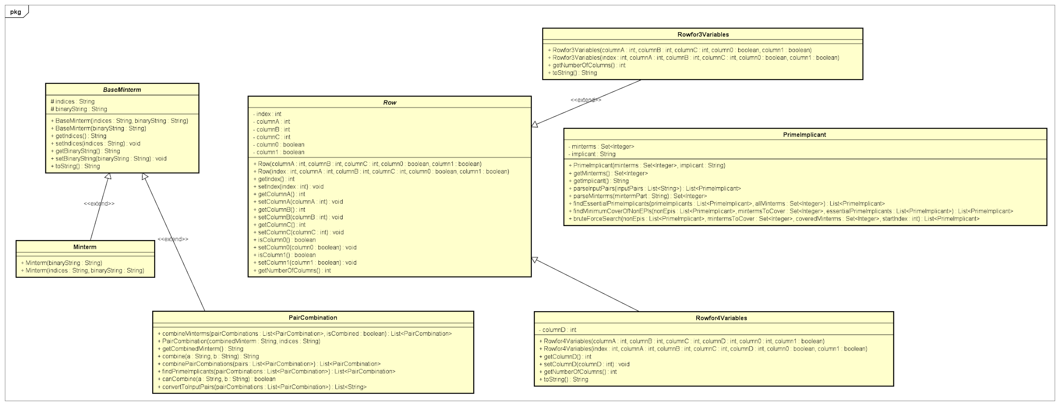
class diagram for model

Slide 7
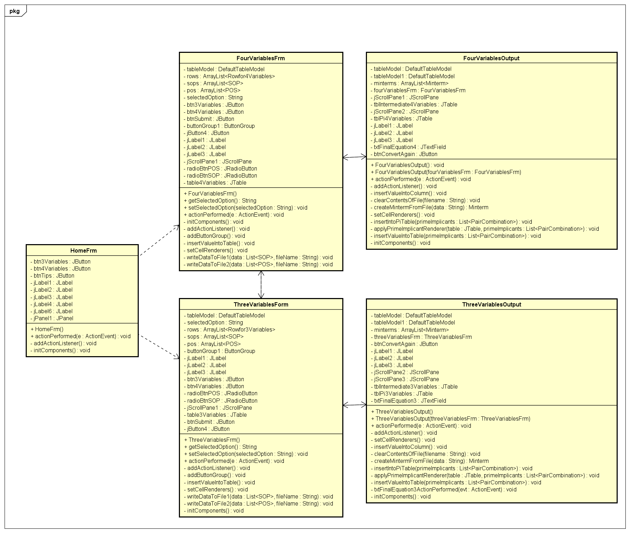
class diagram for view

Slide 8
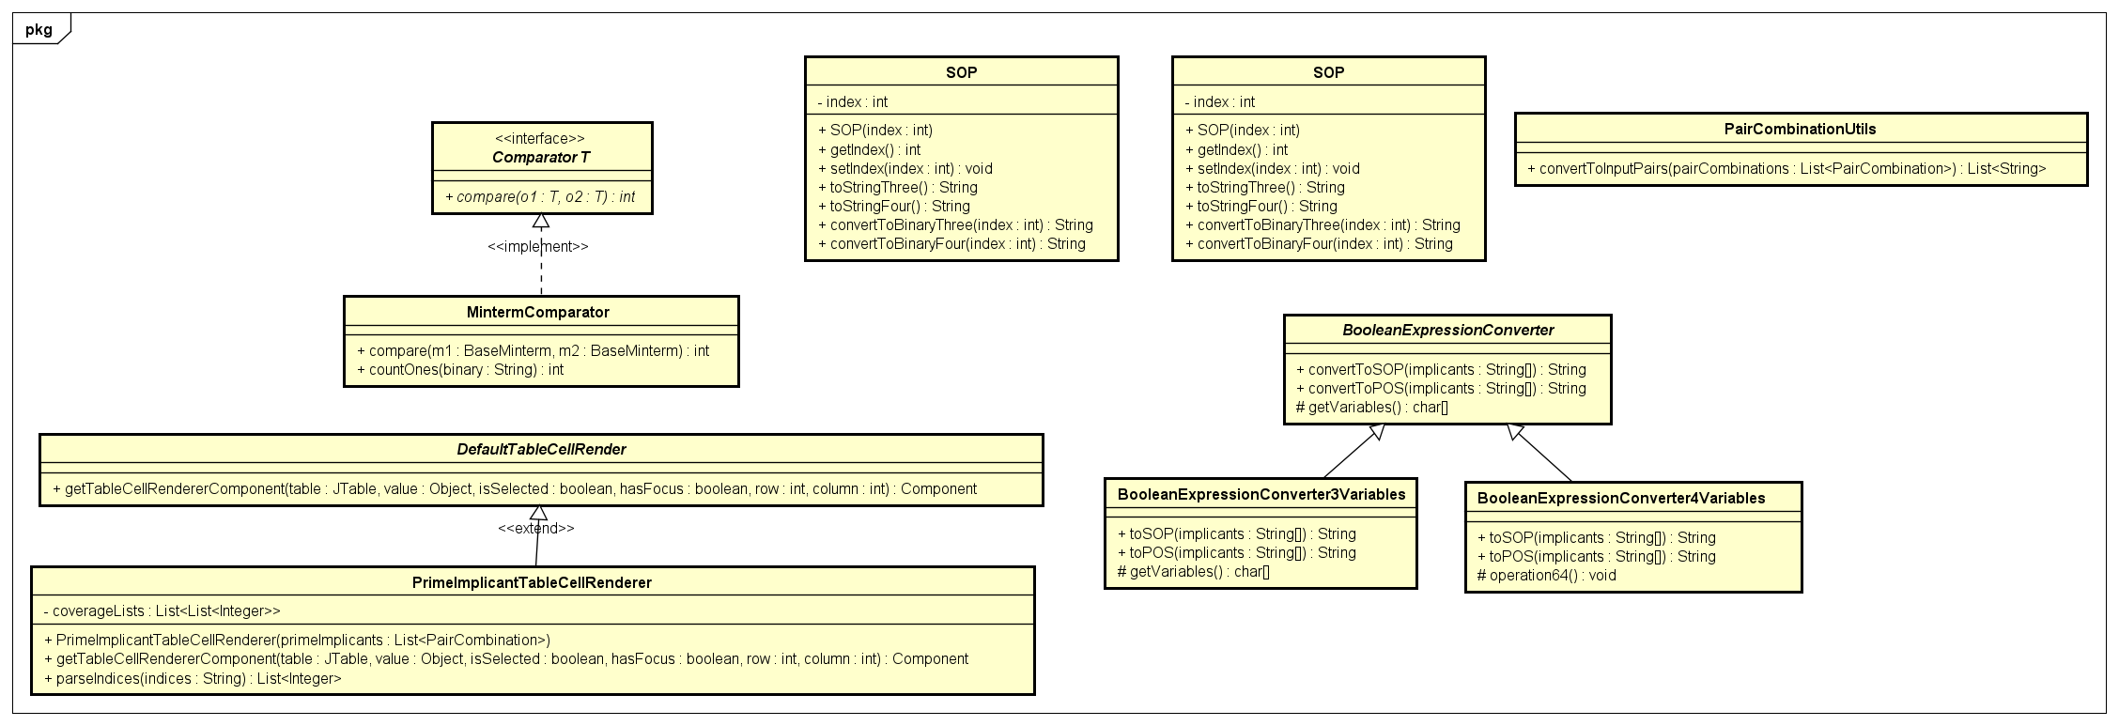
Controller class diagram

Slide 9
Explanation of oop design
The aggregation relationship is used among the Minterm class, the PairCombination class and the ThreeVariablesOutput , the FourVariablesOutput.
The Minterm and PairCombination both inherit the BaseMinterm class. The Rowfor3Variables and Rowfor4Variables inherit the Row. The BooleanExpressionConverter3Variables class and BooleanExpressionConverter4Variables class inherit BooleanExpressionConverter class.

Slide 10
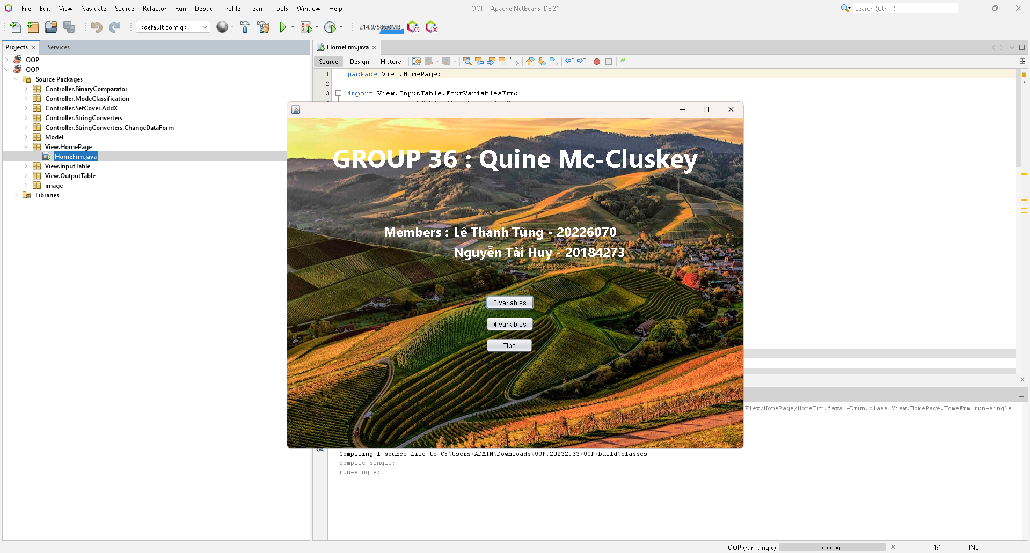
Application demonstration

Slide 11
Thanks

